Slide 1
Warm-Up 8/13/2014
Why should FFA members know the history of the organization?

Slide 2
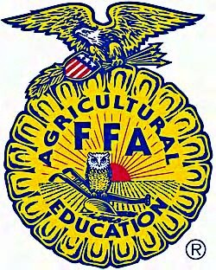
FFA History

Slide 3
Future Farmers of Virginia Established
Arizona Association FFA Chartered
Smith-Hughes Act Established Ag Education
Future Farmers of America Established
Membership restricted to males, Creed adopted
NFA and FFA Merge
FFA Jacket adopted
FFA headquarters established in Alexandria, VA
FFA granted federal charter
National FFA Foundation Established
New Farmers of America Established
Women Admitted
Jan Eberly: First Female Nat’l President
Corey Flournoy: First African-American National President and Urban Student Leader
FFA Alumni Association Founded
Name changed to the National FFA Organization
FFA center moves to Indianapolis, Convention moves to Louisville
FFA goes online
Convention moves to Indianapolis

Slide 4
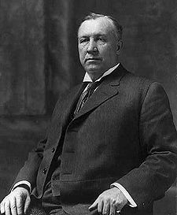
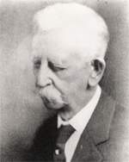
1917
The Smith-Hughes National Vocational Education Act establishes vocational agriculture courses.
Hoke Smith
Dudley Hughes

Slide 5
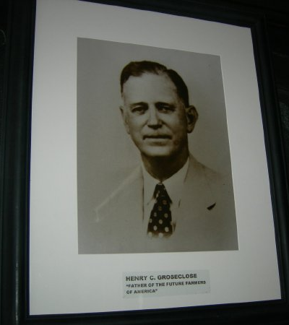
1926
Henry Groseclose, an agriculture teacher trainer and former agricultural education instructor, helps organize the Future Farmers of Virginia for boys in agriculture classes.
Soon similar groups are established across the country. The FFV would be used as a model for creation of the FFA in 1928.

Slide 6
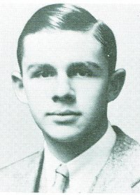
1928
During the American Royal National Livestock Judging Contests in Kansas City, MO, 33 students from 18 states establish the Future Farmers of America to provide leadership training for high school students of vocational agriculture.
During this first annual convention, Leslie Applegate of Freehold, N.J., is elected president and dues are set at 10 cents annually.

Slide 7
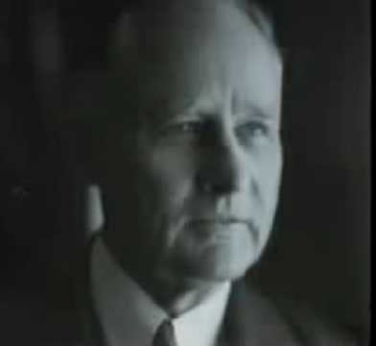
1930
At the 3rd National FFA Convention, the membership issue is clarified when the all-member, male delegation amend the constitution restricting membership to boys only under Article III, Section B.
The official creed is adopted.
E.M. Tiffany, author of the FFA creed

Slide 8
1933
Fredericktown, Ohio, FFA members arrive at the national convention in crisp, blue corduroy jackets with the FFA emblem on the back.
Official delegates vote to adopt the jacket as the organization's official dress.

Slide 9
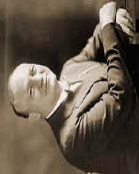
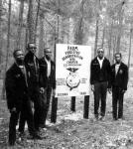
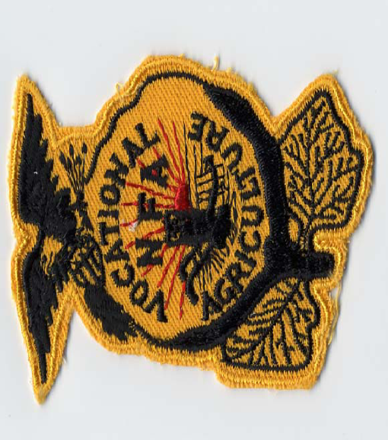
1935
New Farmers of America (NFA), an organization for African-American boys interested in agriculture, is formed and eventually includes 13 states.

Slide 10
1944
The National FFA Foundation, Inc., was established in Washington, D.C., to raise money for FFA programs and activities from business, industry, government, individuals and foundation sponsors.
Today, the Foundation is located in Indianapolis, In., and raises more than $7.3 million annually.

Slide 11
1950
The U.S. Congress passes Public Law 81-740, which grants the FFA a Federal Charter and stipulates that a U.S. Department of Education staff member be the national FFA advisor.
Today FFA continues to be recognized by Congress as an intracurricular part of the educational program.

Slide 12
1959
The FFA headquarters is established in Alexandria, Va., on land which was part of George Washington's estate.

Slide 13
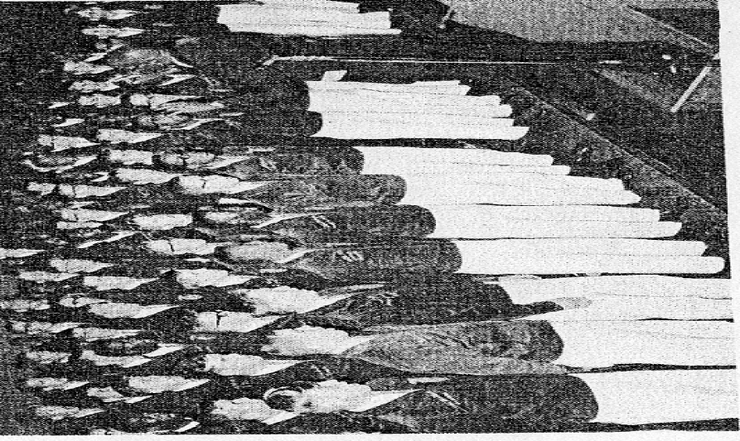
1965
The New Farmers of America (NFA), the organization for African-American agricultural education students, merges with the FFA, adding 50,000 members.

Slide 14
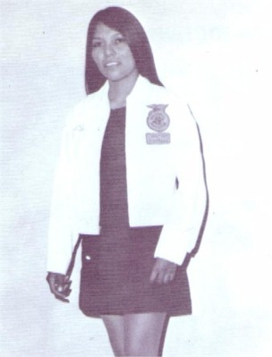
1969
Women are allowed national membership, which made it possible for them to hold office and participate in competitive events at the regional and national level.
Prior to this amendment women were permitted membership only at the local and state level.
Today, 35% of FFA membership is female, while 47% of state leadership positions are held by women.

Slide 15
1971
The National FFA Alumni Association is founded, providing opportunities for former FFA members and other supporters to become involved with their local student chapters.
Today, the Alumni Association has 42,000 members.

Slide 16
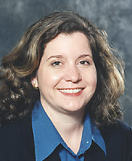
1982
Jan Eberly is the first female elected National FFA President.

Slide 17
1988
Delegates to the national FFA convention change "Future Farmers of America" to the "National FFA Organization" to recognize the growth of agriculture and agricultural education to encompass the more than 300 careers in the science, business and technology of agriculture.
Delegates also opened FFA membership to middle school students.

Slide 18
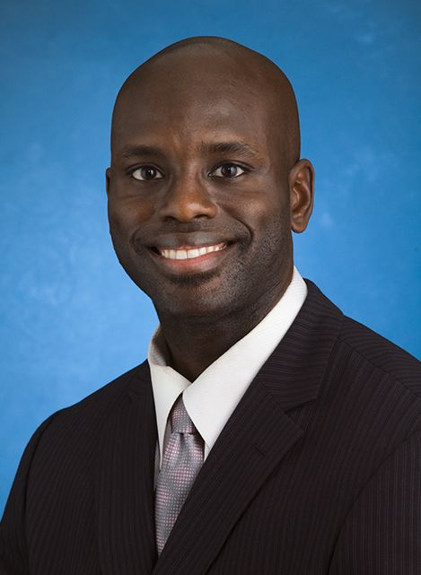
1994
Corey Flournoy of Chicago, Ill., is elected national FFA president, becoming the organization's first African-American president and first urban student leader.

Slide 19
1996
FFA announces its move of the national FFA convention from Kansas City, Mo., to Louisville, Ky.
The FFA web site, National FFA Online, goes live. Today, there are more than 35,000 unique visitors per month.

Slide 20
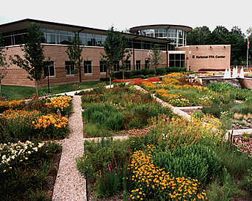
1998
The national convention was held in Kansas City for the last time in November 1998.
Additionally, the National FFA Center was moved from Alexandria, Va., to Indianapolis, In.

Slide 21
2006
National FFA Convention moves to Indianapolis, IN.

Slide 22
Ticket Out
What do you feel are the 3 most influential events in FFA history? Why?

